Slide 1
KeyGuard Key Management System

Slide 2
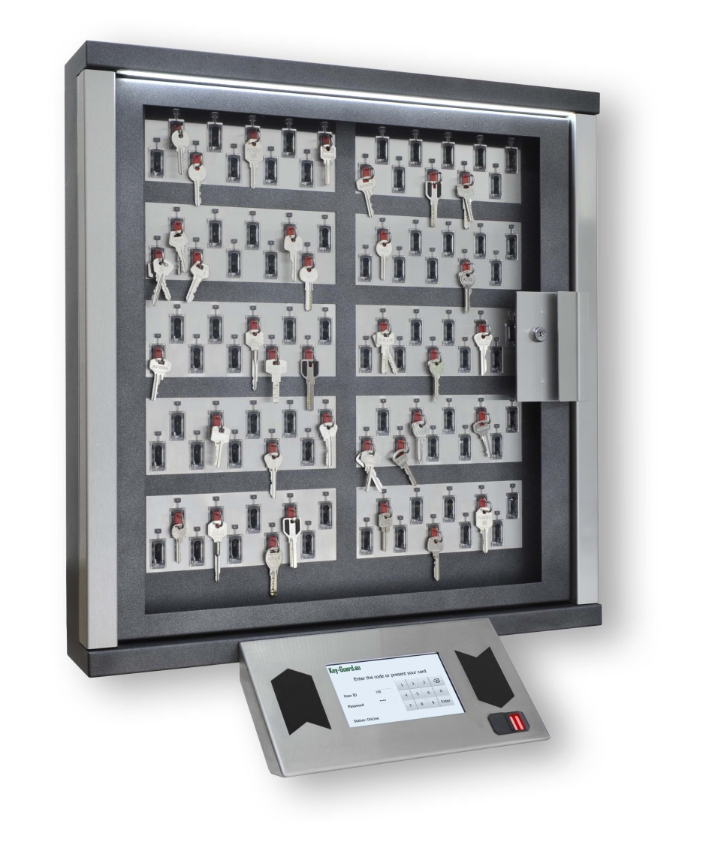
KeyGuard Key management system
15 years experience
Thousands projects
Our Own manufacture
Sophisticated design
Highest quality
Very competitive price

Slide 3
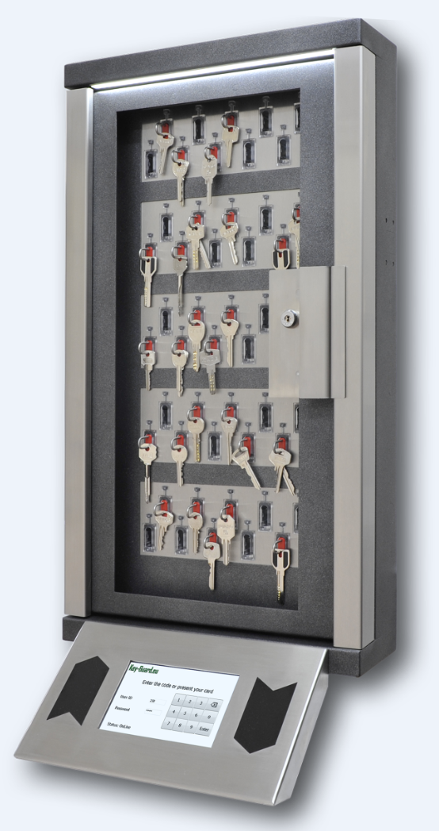
KeyGuard Model of 2017
Automatic issue and storage keys
User friendly interface
Automatic Set arm – Disarm intrusion system
Software development kit available
Cell backlighting
Lock and No lock SmartKeys functions

Slide 4
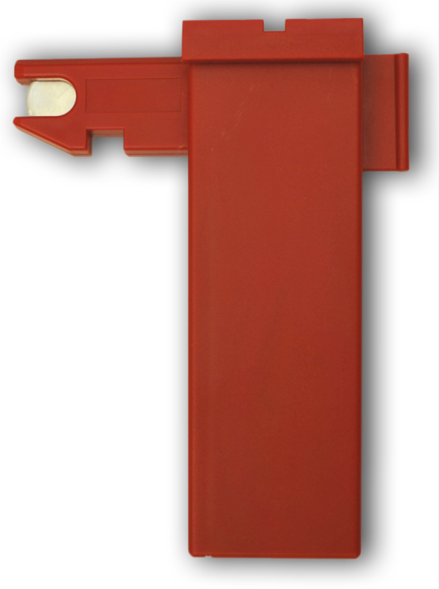
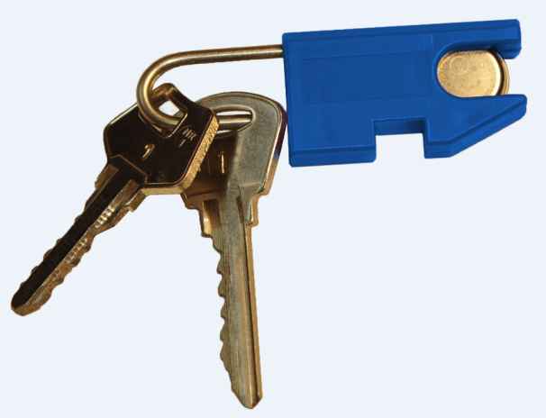
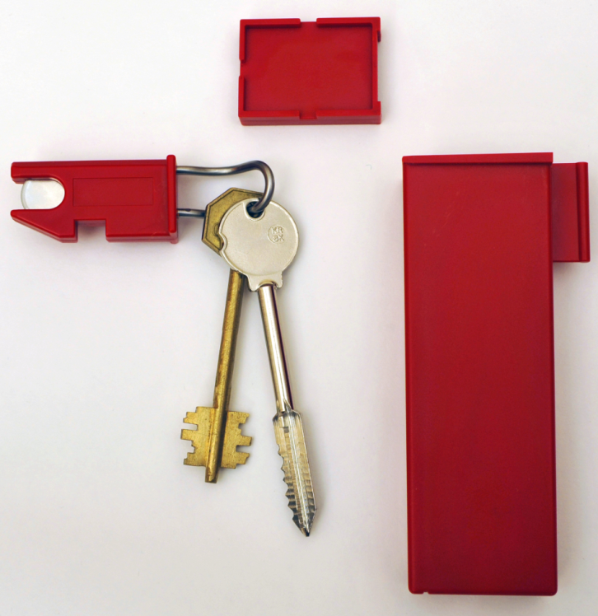
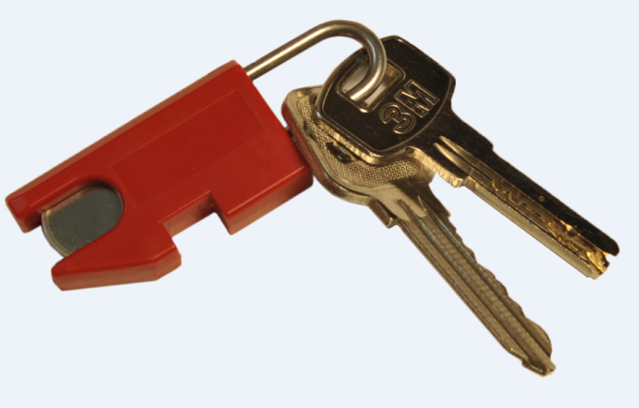
KeyGuard Smart Key and boxes
Storage of the keys on Key Fobs and in the boxes

Slide 5
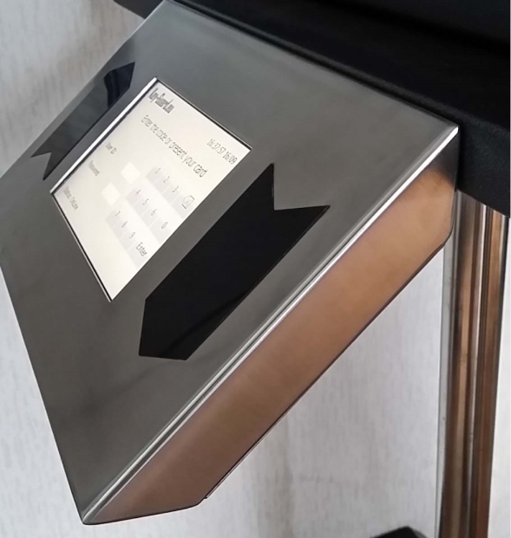
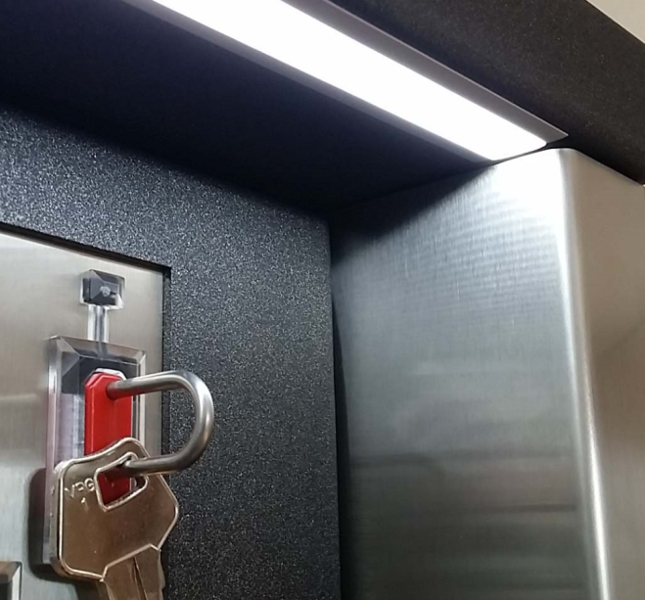
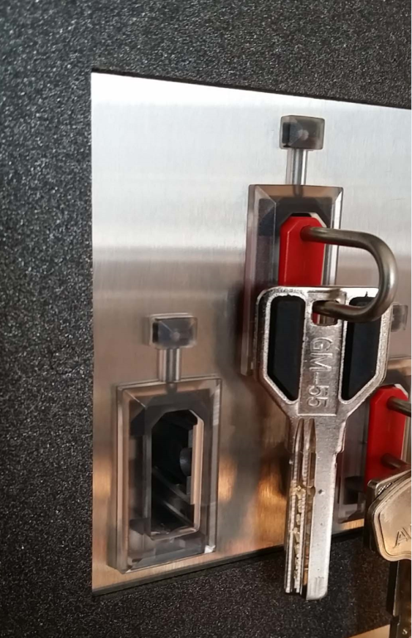
Attention to the details
Control panel very thin
The Key system itself thinnest in the world
Card readers hidden inside
Top Led strip light
Special color and Stainless-steel inserts

Slide 6
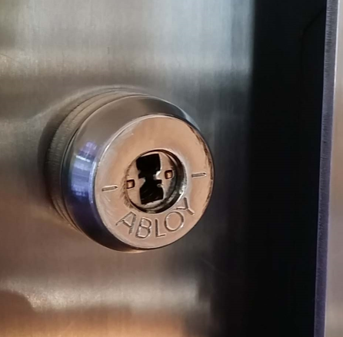
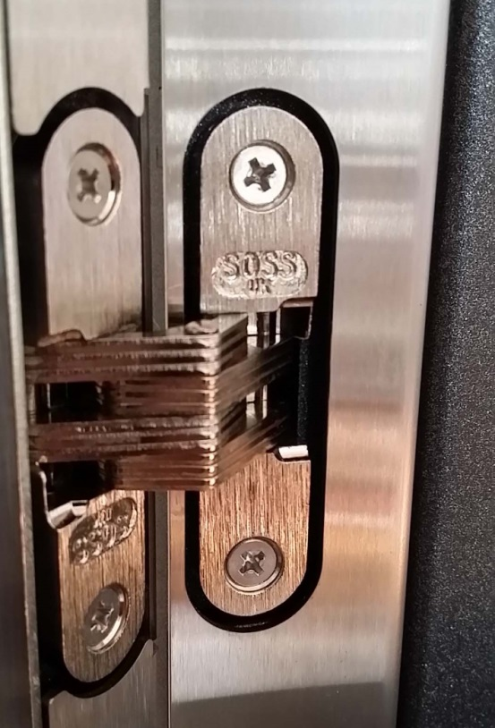
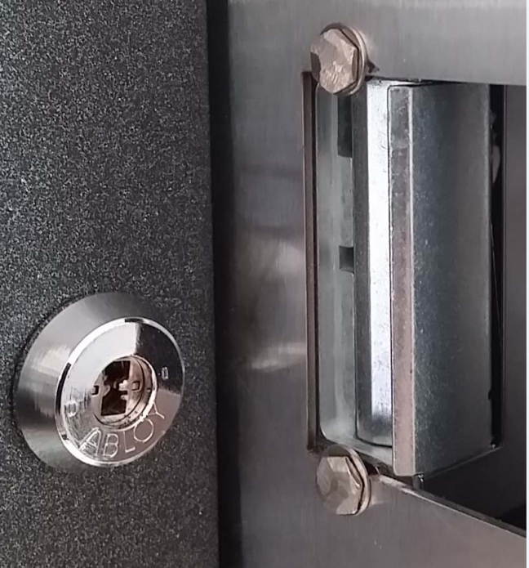
Quality is the first
HSS lock from Abloy
Hinges from Soss England
Eff-Eff Electric lock Germany
Power supply Phoenix Germany
Door contact with sabotage protection

Slide 7
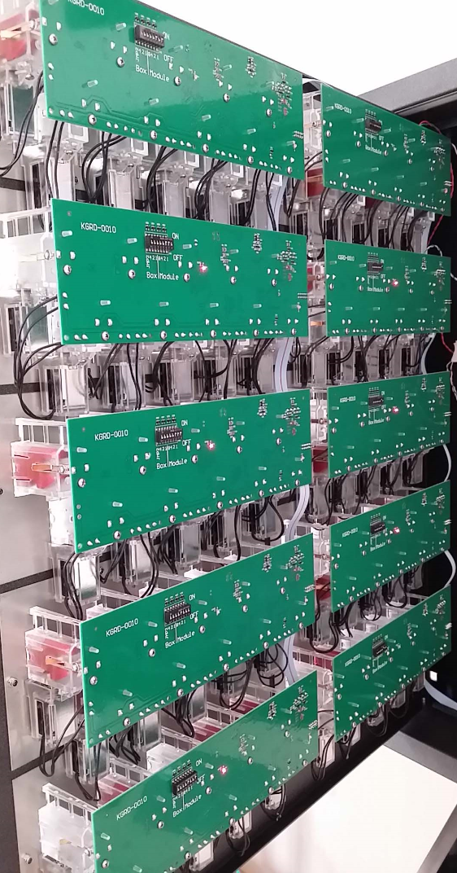
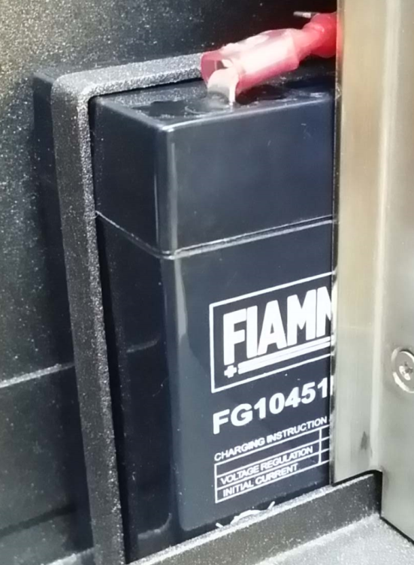
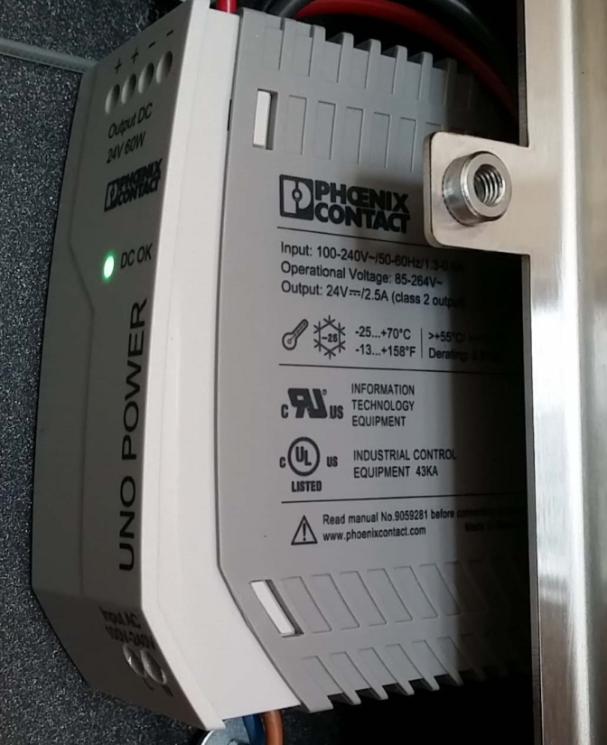
What is inside

Slide 8
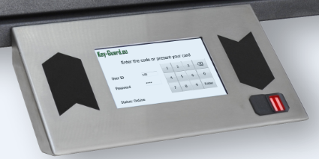
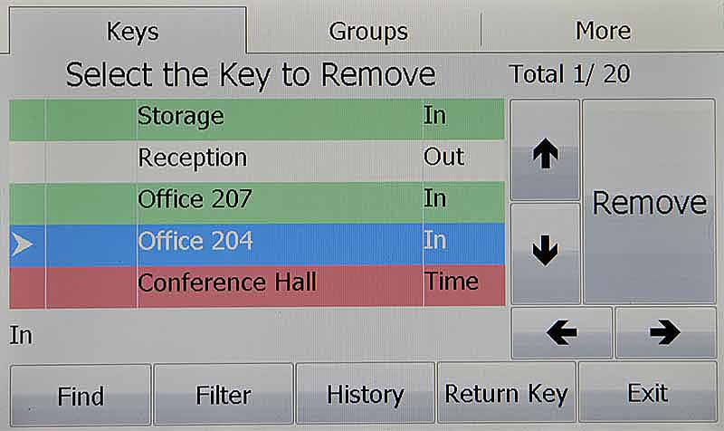
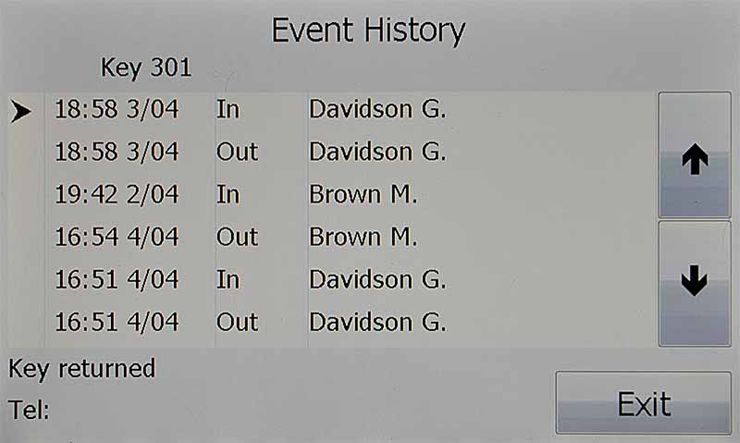
User friendly interface
Super bright TFT
Two readers take in and out
Fingerprint reader from Morpho (option)
Big Font and buttons easy to operate
Event history online
Filter option
Search by Name function,
Search by Number,
Group issue,
Windows Software is included in the package

Slide 9
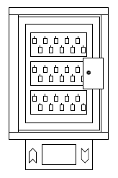
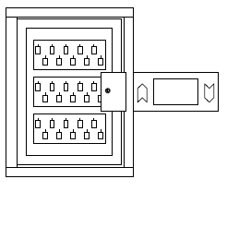
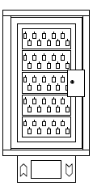
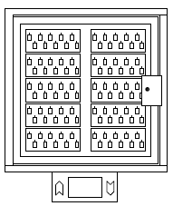
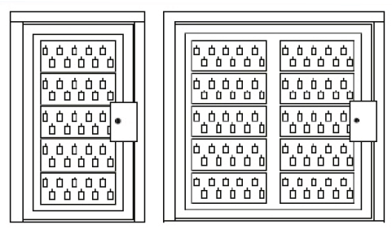
Delivery options
50 000 user database
50 000 events in nonvolatile memory
Glass door
Solid steel door
NO Door
Control panel bottom and right side installation
Ethernet, RS485, RS232
Cabinets for 3,5 and 10 modules
From 20 то 2000 keys to single control panel.
Main cabinet
Add on cabinets

Slide 10
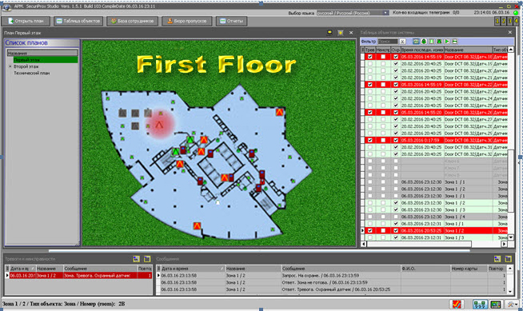
Windows Software included Network operation
Set up and edit keys access levels
Remote control of the system
Print Reports
Alarm management
SMS & email notification
Graphical maps of the Site
Later key return and key overdue alarm triggering
Online information of the Keys status
Network connection

Slide 11
World requirements of the Key system
Market establishing
Kick back from access control to the Key system

Slide 12
Solutions
Automatic issue and storage of the Keys
Automatic Log event files
Automatic Arm Disarm intrusion system
Emergence (Fire case) keys storage
Reducing staff number – real savings
Increasing secure level of the Site
Short up time of issue for emergency cases (Fire alarm)

Slide 13
Markets
Airports
Healthcare
Education
Hotels
Military
Business
Industry
Companies car park
Hotels technical rooms
Technical support
Government
Transport
Data centers
Electric cabinets and other like transformer stations for electric companies
No Lock function of smart keys 30% less
Car dialers
Bank vending machined ATM
Municipal

Slide 14
Thank you! KeyGuard Key management system

